Slide 1
We Worked Steps

Slide 2
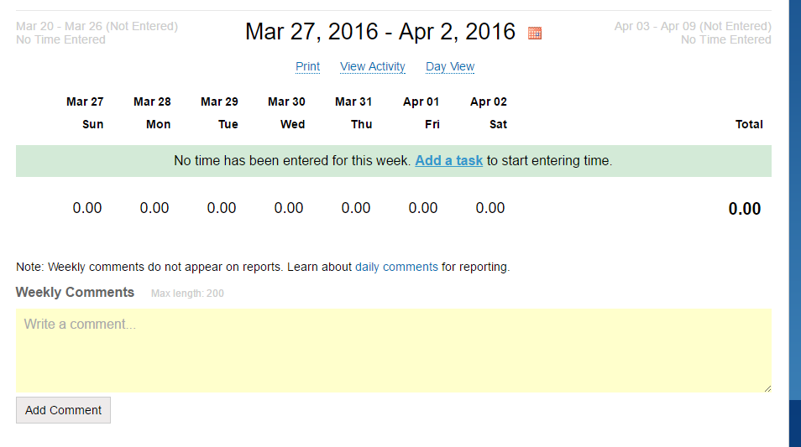
Step 1: add task
- once you add task you will be able to enter your hours into the given days
Example: 0.00 for March 28 would be entered 8.00

Slide 3
Step 2: After entering time it should state the given hours
8.0
8.0
8.0
8.0
8.0
40.0

Slide 4

Step 3: in the drop down tool for project: select Cohort 2015

Slide 5
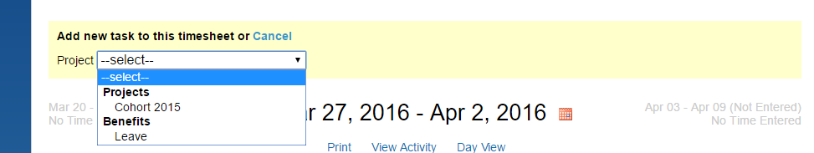
Step 4: in the drop down tool for project: select Cohort 2015

Slide 6
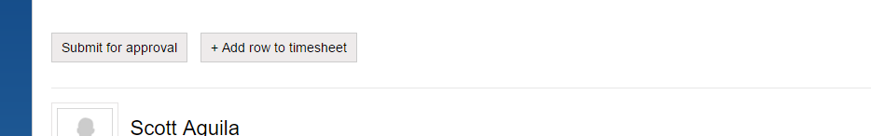
Step 5: submit your time
- click the Submit for approval button; James will then approve your timesheet

